Slide 1

Ontologies for the Study of Neurological Disease
Mark Jensen
ICBO 2012—Workshop on Mental Functioning
July 22, Graz, Austria
Notes:
TURN OFF GMAIL NOTIFIER!

Slide 2
Ontologies for the Study of Neurological Disease
Alexander P. Cox¹, Mark Jensen¹, William Duncan¹, Bianca Weinstock-Guttman³, Kinga Szigeti³, Alan Ruttenberg², Barry Smith¹ and Alexander D. Diehl³
¹ Department of Philosophy, University at Buffalo
² Department of Oral Diagnostic Sciences, University at Buffalo School of Dental Medicine
³ Department of Neurology, University at Buffalo School of Medicine and Biomedical Sciences

Slide 3
Neurological Disease Ontology (ND)
Representation of all entities relevant to neurological diseases encountered in clinical practice and research
NeuroPsychological Testing Ontology (NPT)
Representation of the assays and data associated with neuropsychological testing

Slide 4
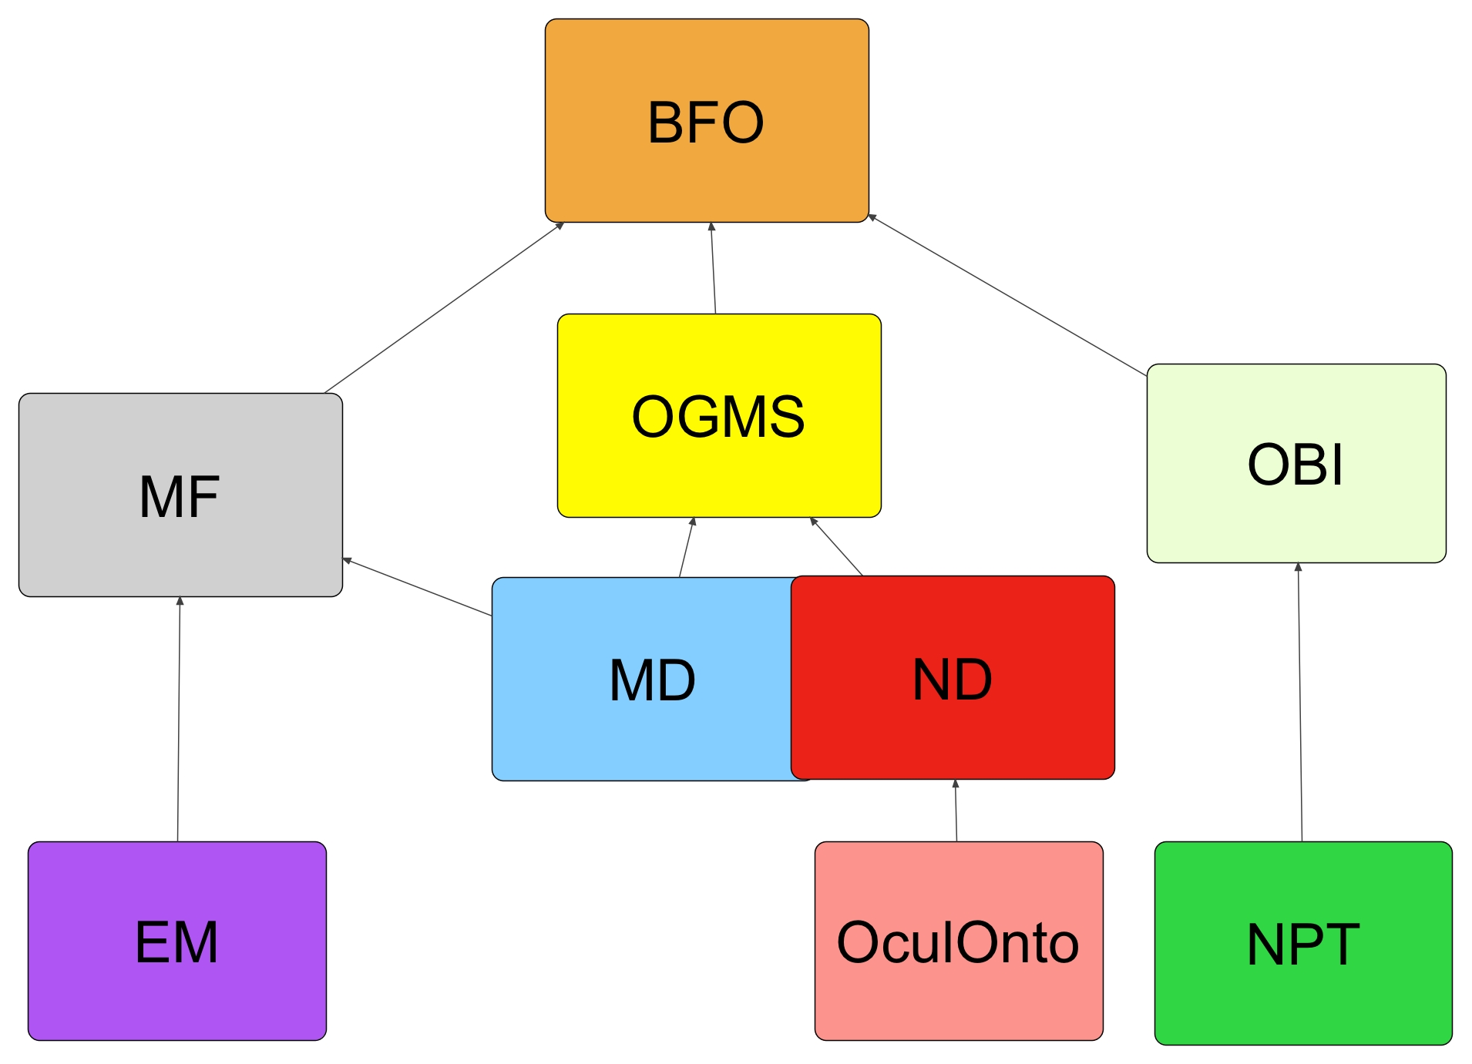

Slide 5
Ontology for General Medical Science—OGMS
Reference ontology that represents the major types of entities involved in a clinical encounter
Core terms: 'disease', 'disorder', 'disease course', 'diagnosis', ‘syndrome’, ‘diagnostic process’
OGMS:disease is a disposition (i) to undergo pathological processes that (ii) exists in an organism because of one or more disorders in that organism.

Slide 6
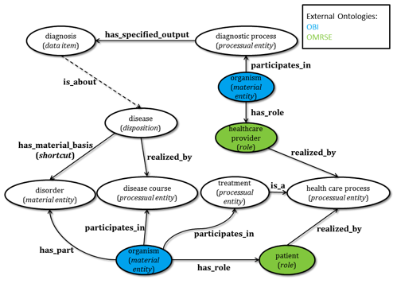

Slide 7
Neurological Disease Ontology—ND
An extension of OGMS
Three initial areas of focus
Dementia, in particular Alzheimer’s disease
Multiple sclerosis, demyelinating diseases
Stroke, cerebrovascular events
Application driven

Slide 8
ND—Goals
Provide a comprehensive representation of neurological diseases
Support clinicians and researchers in the diagnosis, treatment, and study of these diseases
Facilitate querying of medical databases, connect structured descriptions in clinical and translational medicine, in EHRs and published research
Participate in ongoing collaborative development of other ontologies

Slide 9
ND—Status
Approximately 400 classes, more than 50 have logical definitions, direct imports and external references where possible
200 types of ‘neurological disease’
‘disorder’, ‘disease course’, ‘syndrome’, ‘diagnosis’

Slide 10
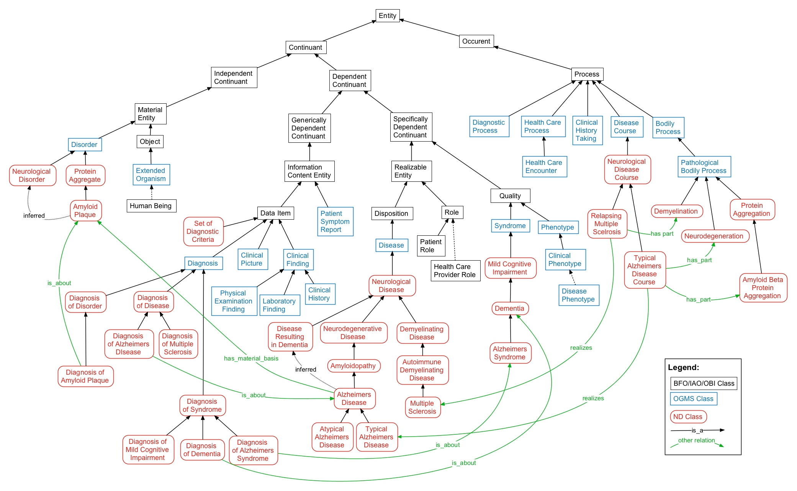

Slide 11
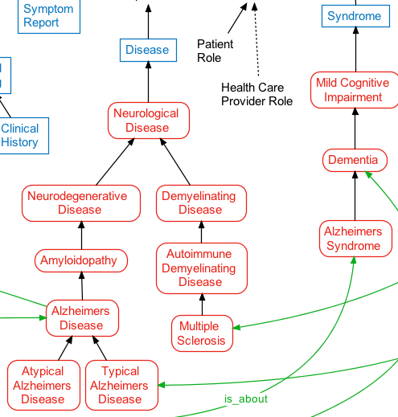

Slide 12
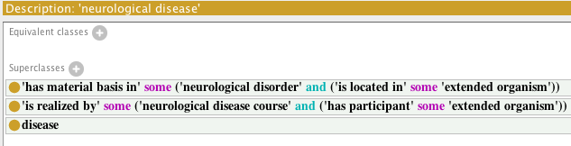
‘neurological disease’
A disease which is realized by a neurological disease course and has material basis in some neurological disorder. Neurological diseases affect the functioning of the nervous system and are caused by structural, biochemical, or electrical abnormalities in the brain, spinal cord, peripheral nerves, plexus or glia.

Slide 13
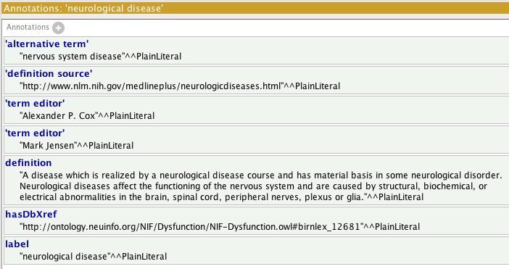
Annotations for ‘neurological disease’

Slide 14
Neurological Disease Mechanisms
Neurodegenerative
Primary
Alzheimer disease, Parkinsons
Secondary
Infectious, nutritional
Diseases of Myelin
Demyelinating: multiple sclerosis
Dysmyelinating: leukodystrophies

Slide 15
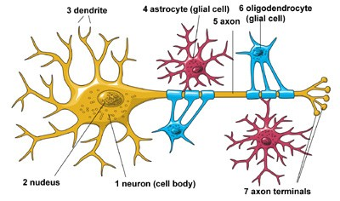
Degeneration vs. Demyelination

Slide 16
Disease Classification in ND:
ND attempts to classify every neurological disease according to its primary mechanism.
Other useful classifications, such as anatomical (e.g. central nervous system disease) and symptomatic (e.g. disease resulting in dementia), or by secondary mechanisms can also be inferred from the logical definitions.

Slide 17
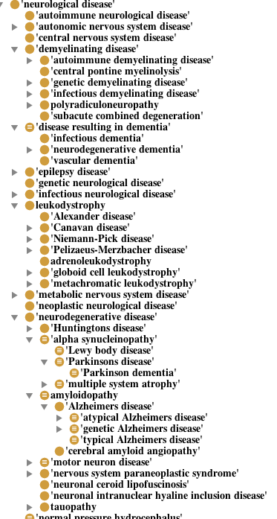
Diseases

Slide 18
Alzheimer’s Disease
Alzheimers disease is a neurological disease where cognitive deficits occur that represent a decline from previous levels of functioning resulting in dementia caused by neurodegeneration as a result of deposition of amyloid plaques and neurofibrilary tangles in the medial temporal lobes.

Slide 19
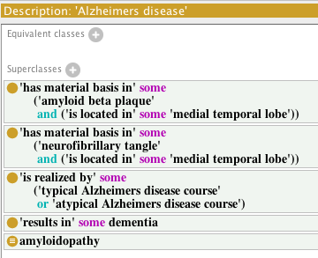
Alzheimer’s Disease

Slide 20
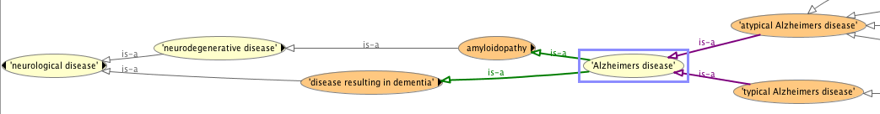
Alzheimer’s Disease

Slide 21
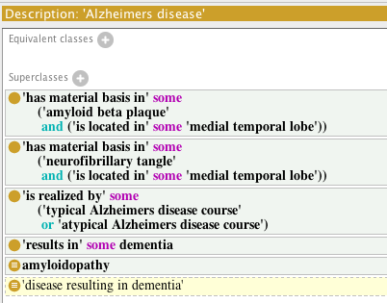
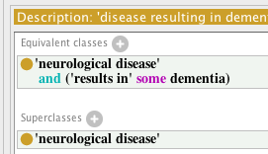
Alzheimer’s Disease

Slide 22
NeuroPsychological Testing Ontology—NPT
An extension of the Ontology for Biomedical Investigations (OBI) to represent the assays and data associated with neuropsychological testing
Initial goals
Test hypotheses regarding diagnosis of Alzheimer’s Disease
Identify patient populations that are likely to convert from Mild Cognitive Impairment (MCI) to AD
Supporting development of patient registry at Buffalo

Slide 23
Neuropsychological Testing
Neuropsychological tests used for a variety of neurological or mental diseases, and complications. They are a primary part of conducting neuropsychological assessment in clinical contexts. Involve personal, interpersonal and contextual factors as well.
Development of NPT began with the representation of the Folstein Mini Mental State Examination (MMSE). Work is currently being done to add representations of neuropsychological tests that assay executive and memory cognitive functioning.

Slide 24
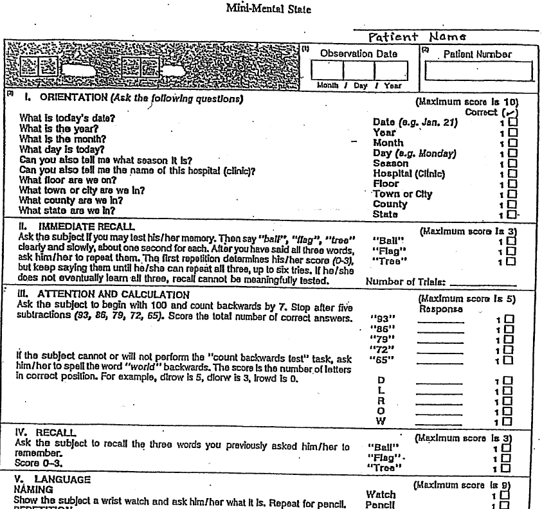

Slide 25
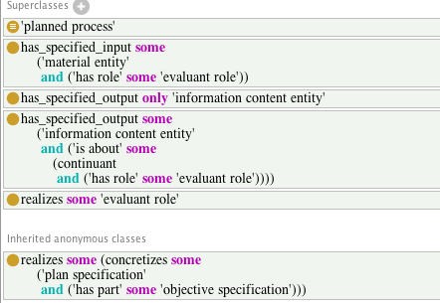
OBI:assay
is a planned process with the objective to produce information about some evaluant

Slide 26
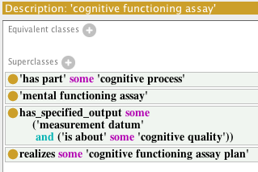
NPT
‘cognitive functioning assay’ is an assay that measures one or more aspects of an evaluant's cognitive functioning

Slide 27
NPT: ‘Folstein mini mental state examination assay’
An cognitive functioning assay consisting of a standardized sequence of brief cognitive tasks emphasizing orientation, memory, attention, and language that generates a score from 0 to 30 that is used as a global measurement of cognitive functioning and to screen for cognitive impairment in the evaluant.

Slide 28
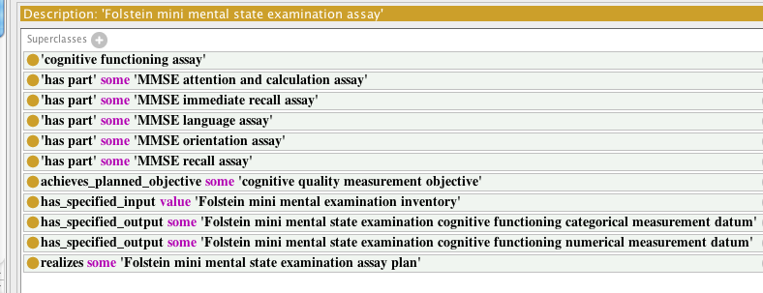
NPT:‘Folstein mini mental state examination assay’

Slide 30
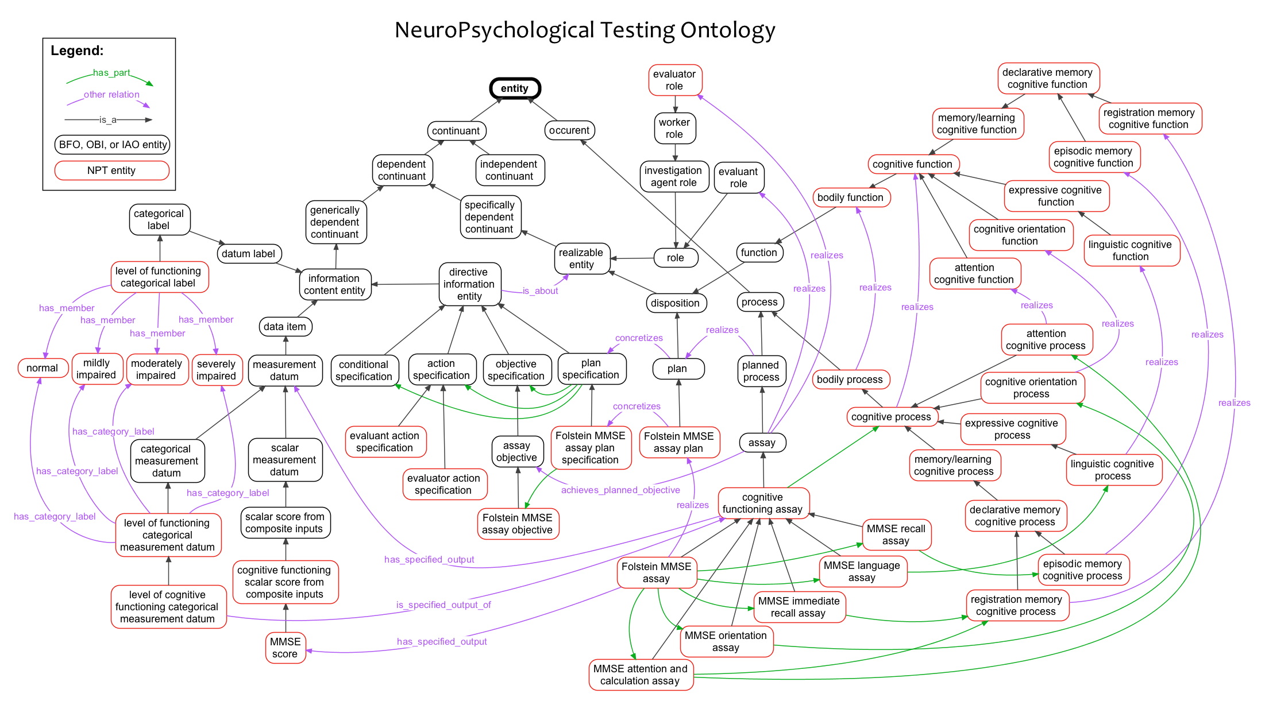

Slide 31
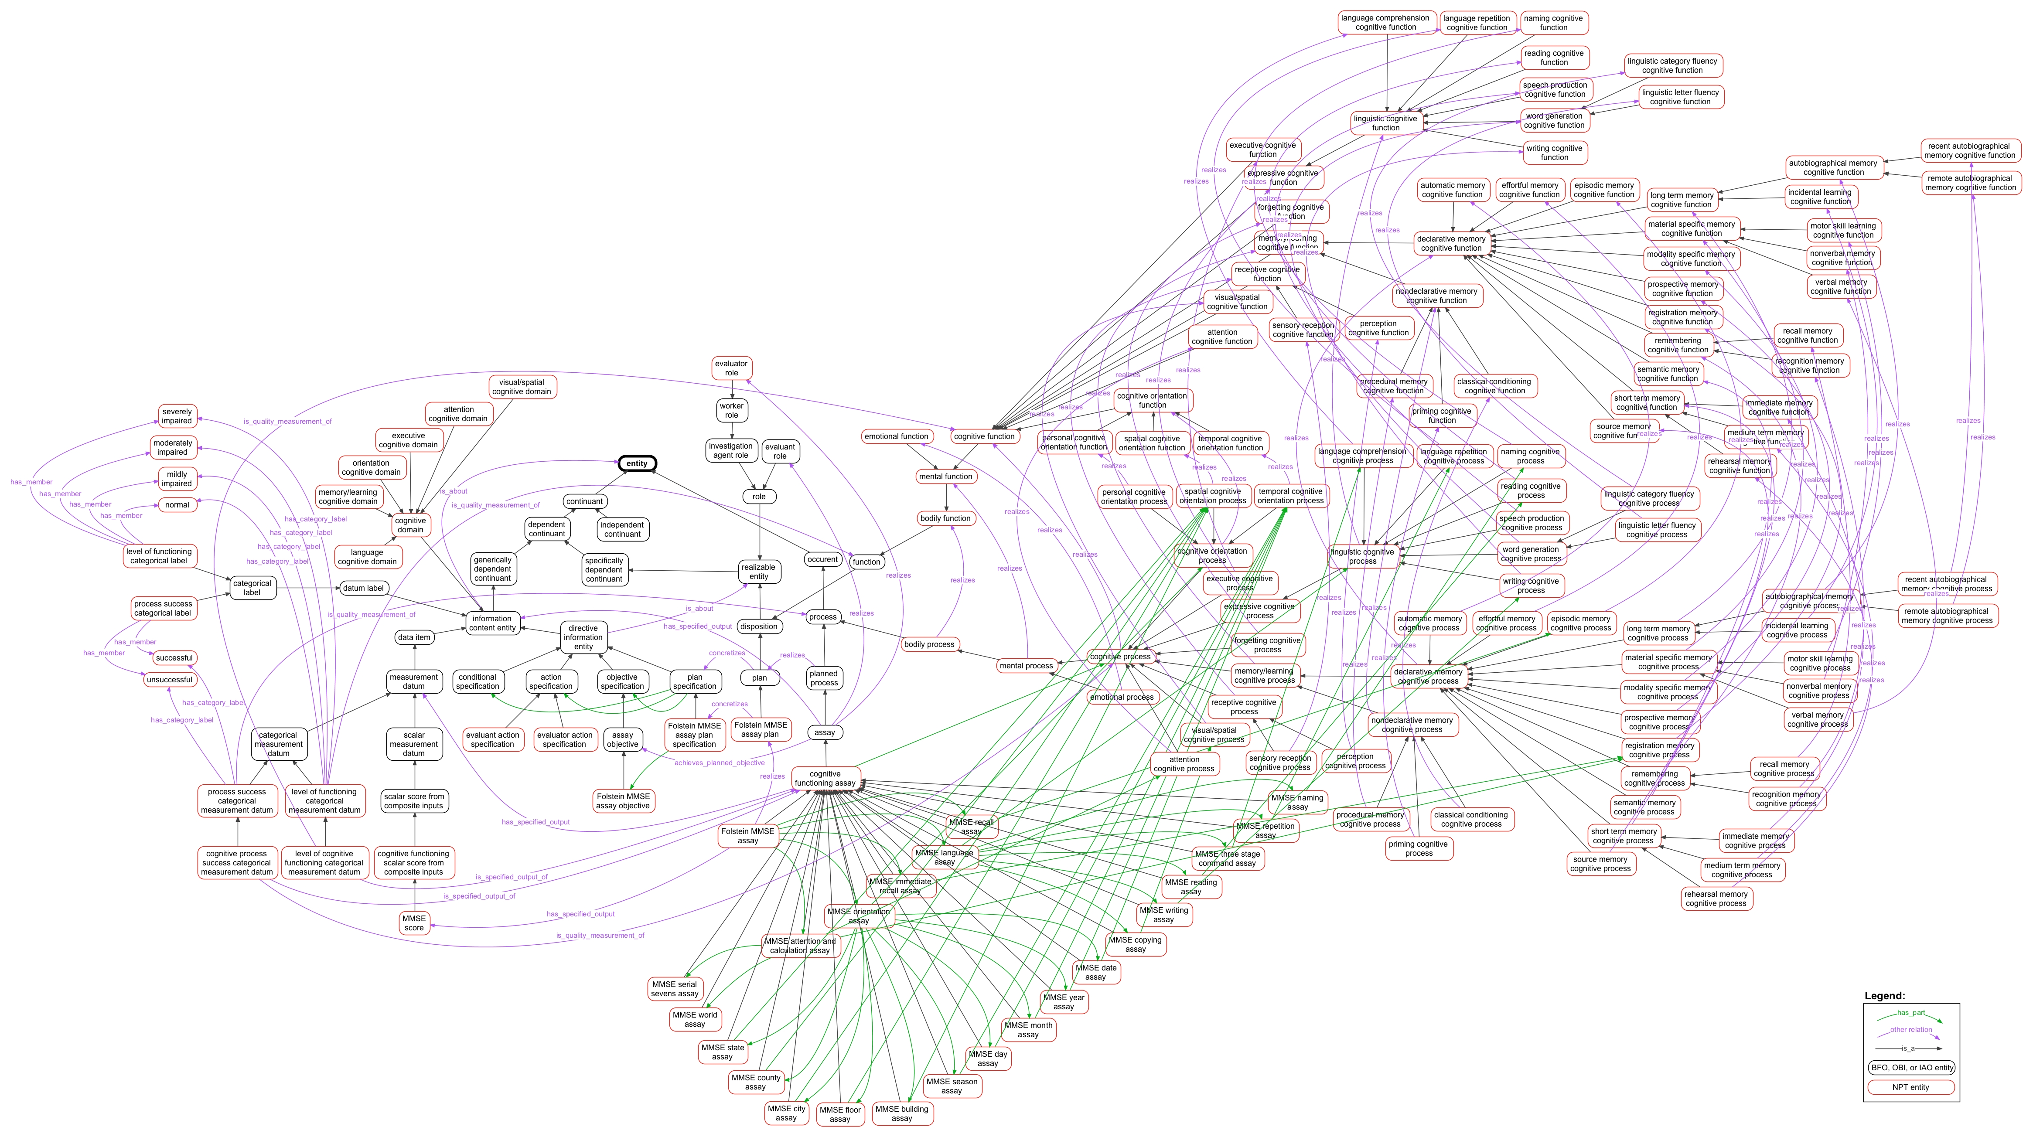
NeuroPsychological Testing Ontology

Slide 32
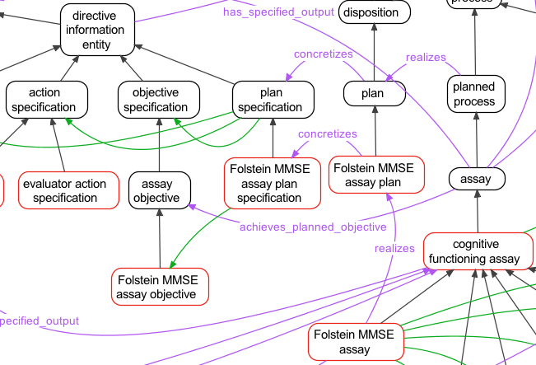
NeuroPsychological Testing Ontology

Slide 33
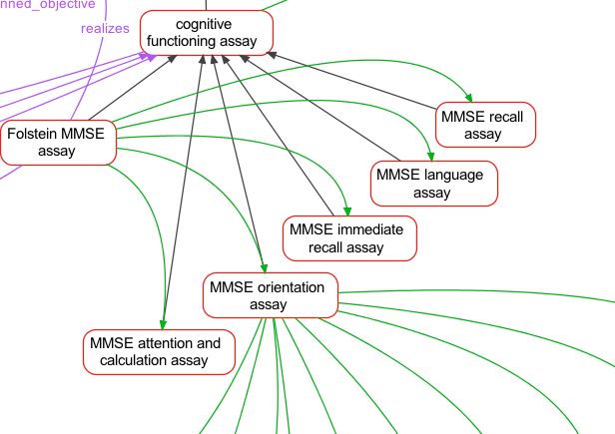
NeuroPsychological Testing Ontology

Slide 34
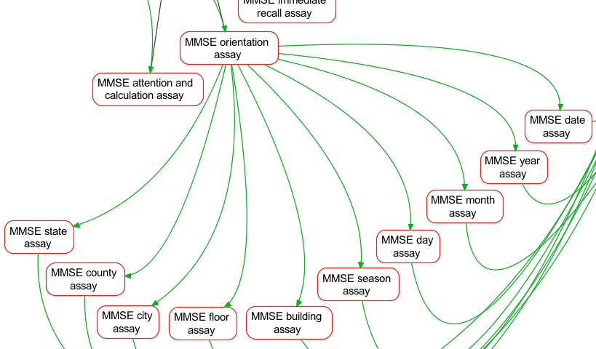
NeuroPsychological Testing Ontology

Slide 35
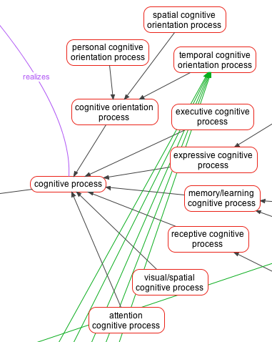
NeuroPsychological Testing Ontology

Slide 36
Summary
ND and NPT
Alzheimer’s disease, multiple sclerosis, dementia, neuropsychological testing, stroke
Clinical focus
Applications
Collaboration!

Slide 37


Slide 38
Acknowledgments
Alexander D. Diehl Bianca Weinstock-Guttman
Alexander P. Cox Kinga Szigeti
Patrick Ray Ralph Benedict
Alan Ruttenberg Naveed Chaudhry
William Duncan Marcus Ng
Barry Smith Donat Sule

Slide 39
Thanks!
http://code.google.com/p/neurological-disease-ontology/
http://code.google.com/p/neuropsychological-testing-ontology/
Alexander D. Diehl - addiehl@buffalo.edu (director)
Alexander P. Cox - apcox@buffalo.edu
Mark Jensen – mpjensen@buffalo.edu

